Slide 1
Market Update, 2/15
Quant Lab
Israel Diego

Slide 2
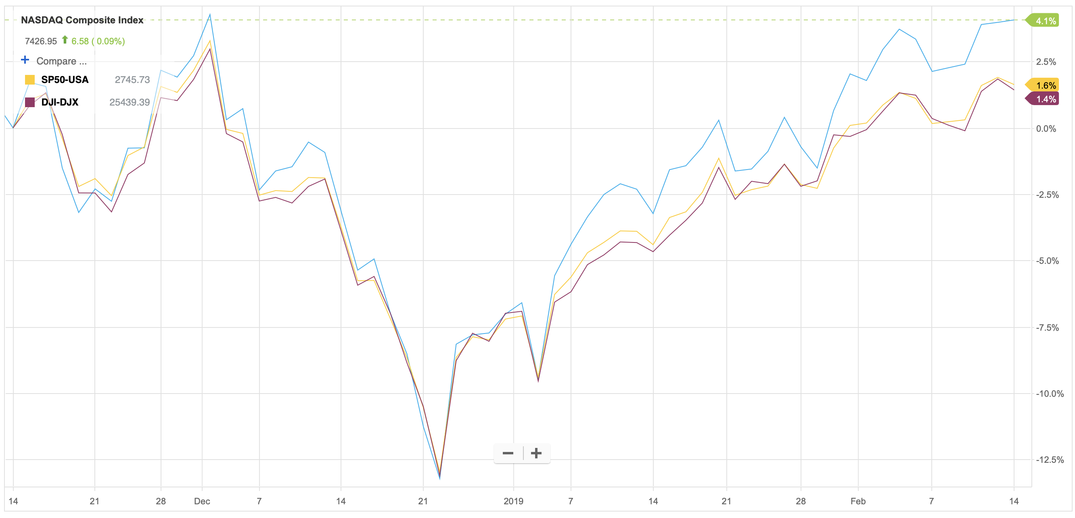
What happened this week?

Slide 3
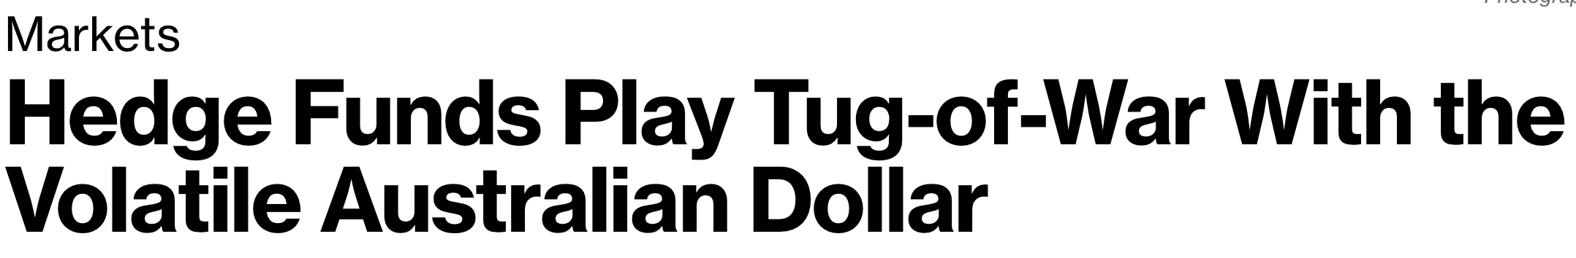
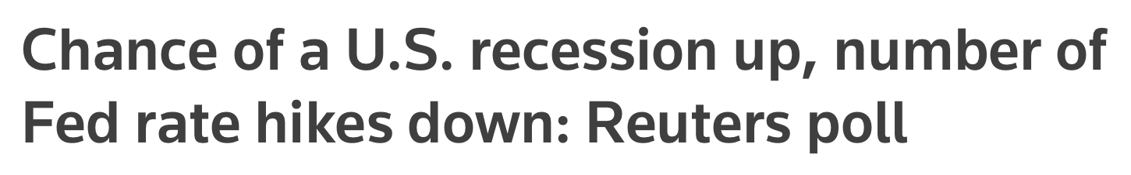
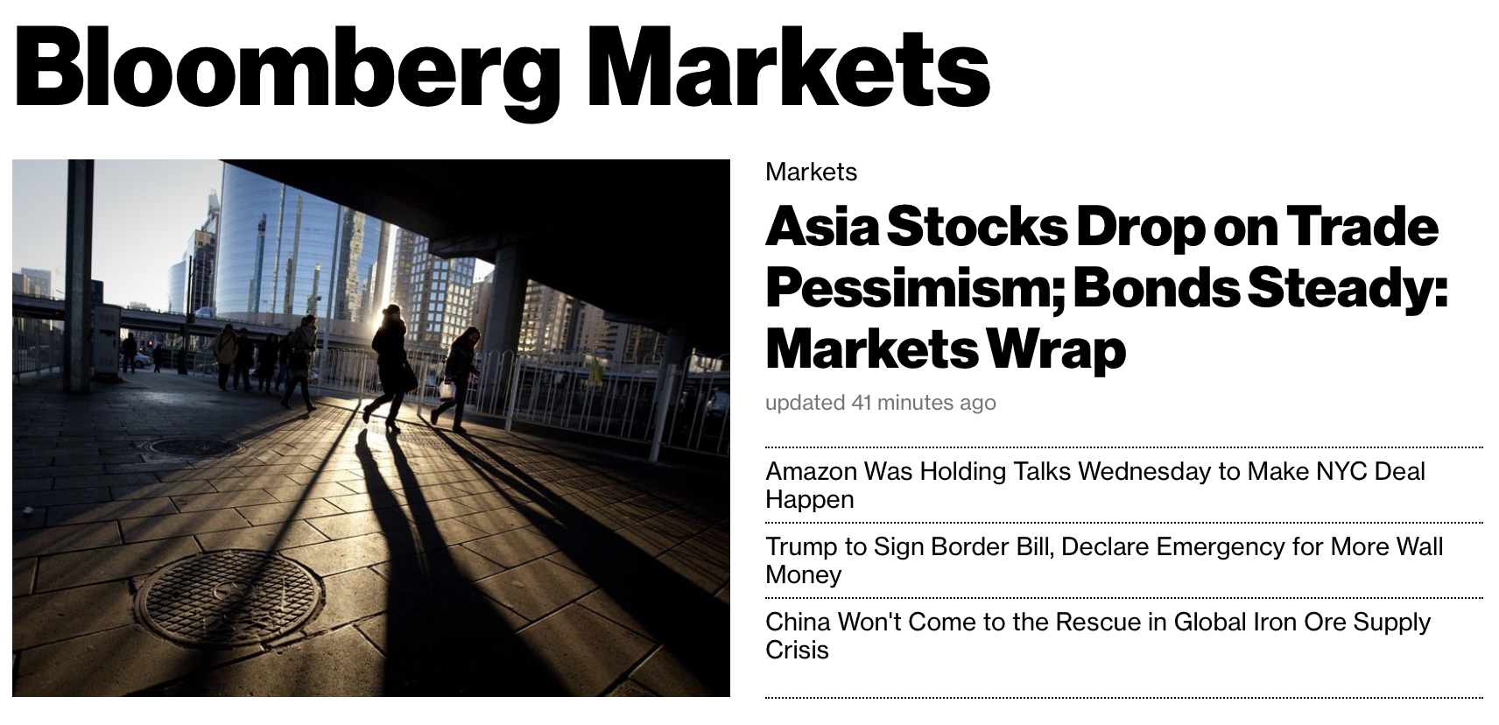

Slide 4
News Links
Fed rate hikes down
Volatility of Australian Dollar
Asia Stocks Drop on Trade Pessimism
Amazon cancels New York plans
Trump to Sign Border Bill

Slide 5
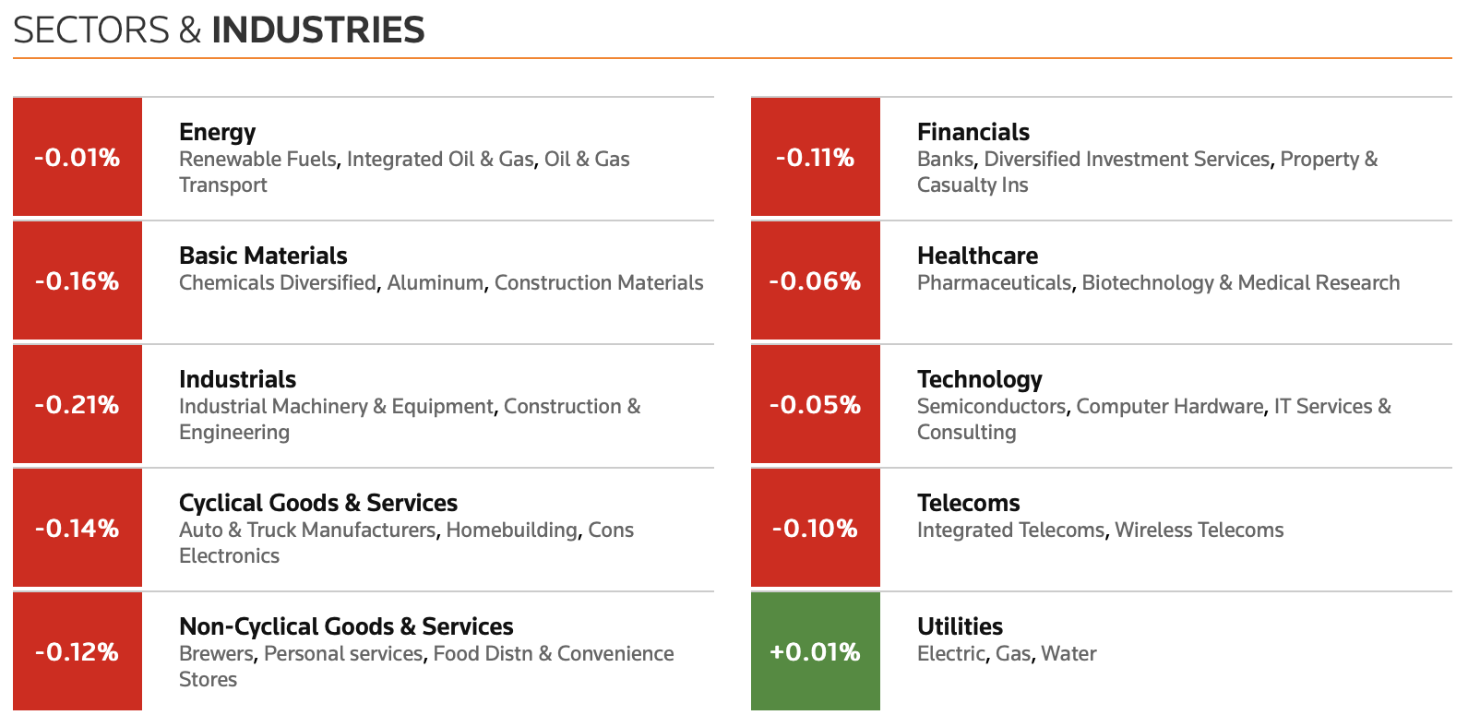
Sectors
Source

Slide 6
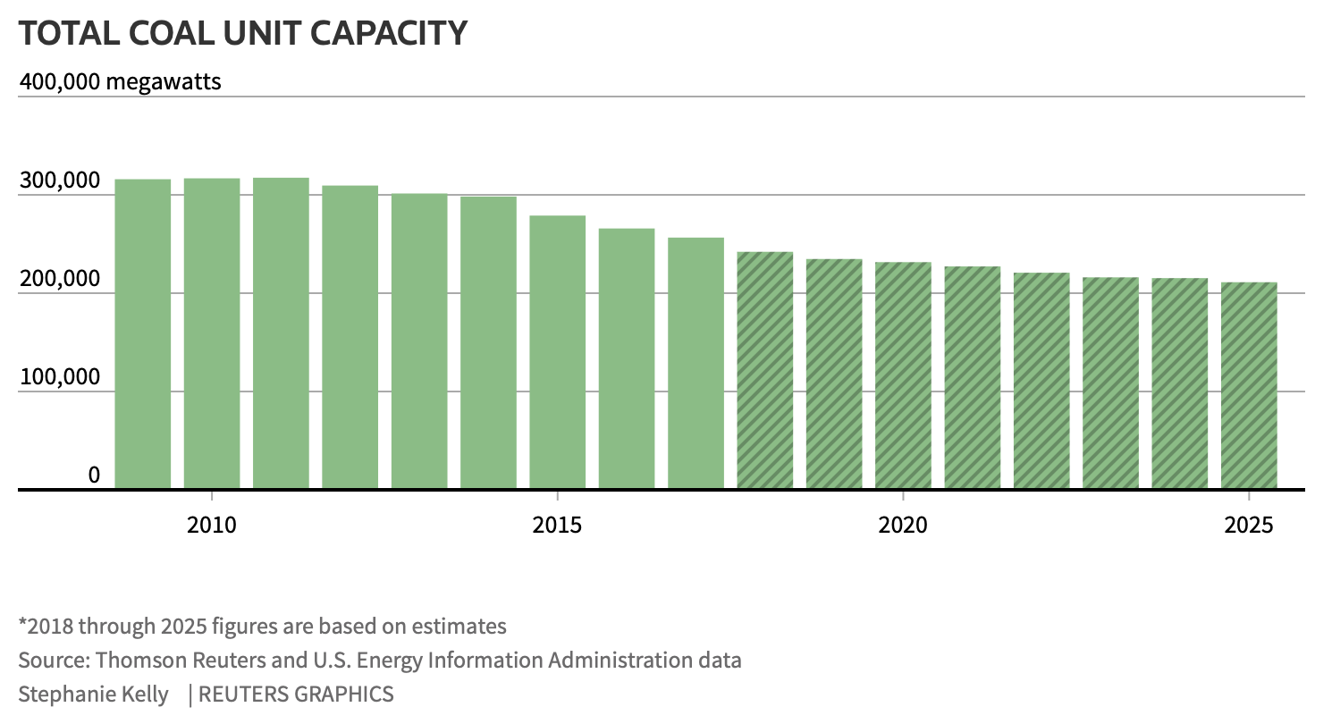
Energy Down?
Source

